Slide 1
Introduction to Image Processing and Analysis
July 20th and 22nd
How to load, read and obtain information from grayscale and color images
José Serrado Marques
Adapted from Nuno P Martins and TS14 Neubias school
Notes:
Have Fiji open and ready to go.

Slide 2
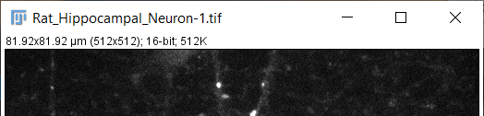
Images in Fiji
Open Fiji
File > Open Samples > Neurons
Duplicate the first channel (Ctrl + Shift + D)
Read the info on the top of the image window
Image dimensions (in pixels); bit-depth; Image size
Info on top may differ, depending on the image you’re seeing
Check image metadata:
Image > Show info (Ctrl + I)
Image > Properties (Ctrl + Shift + P)
Notes:
When images are not calibrated, image dimension show is pixels

Slide 3
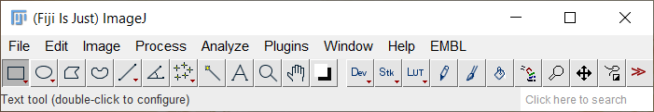
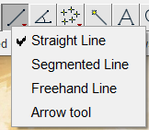
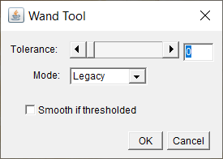
The toolbar
Has more tools
Rectangular ROI
Line ROI
Zoom Tool
Right click to show more options
Wand tool
Hold Shift to make the ROI uniform
Double click to change tool parameters
ROI = Region Of Interest
Notes:
Ficar a mexer com os controlos numa imagem

Slide 4
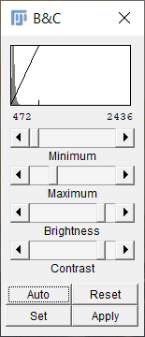
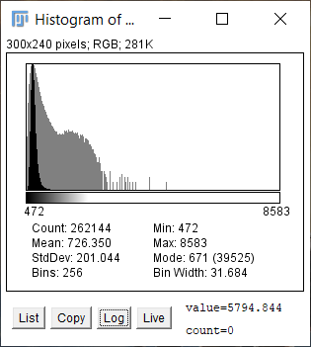
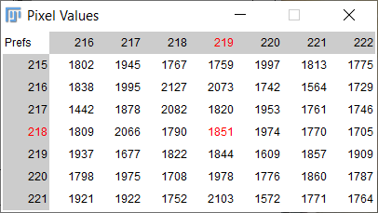
Image Histogram
Image Histogram show the how many pixels (Y-axis) have a certain gray (or intensity) value (X-axis)
Let’s have a look at pixel info using 3 different tools:
Pixel Inspector (in the toolbar)
Histogram (Ctrl + H) and Brightness and Contrast (Ctrl + Shift + C)
Hit apply and see what happens to the pixel values using the other tools
Notes:
Also show where to find it. Log is helpful to see pixel values with low pixel counts.

Slide 5
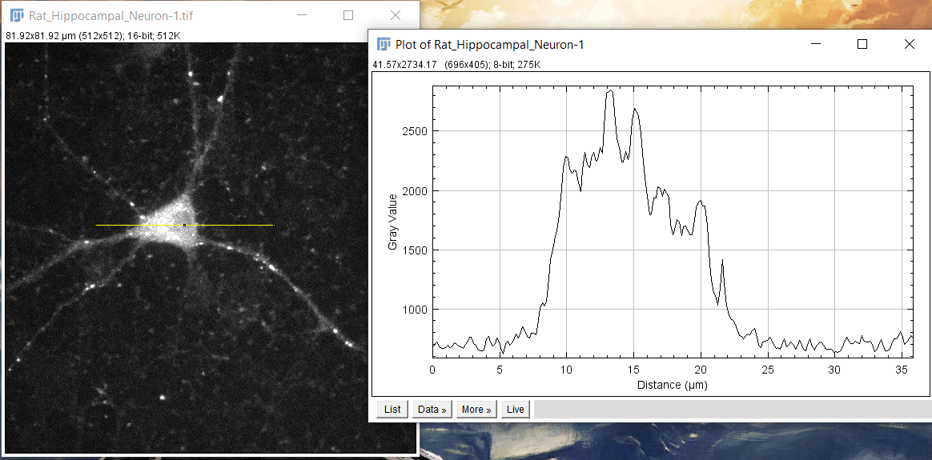
Plot Profile
Draw a line over the cell and do a plot profile (Ctrl + K). Is also under Analyze > Plot profile
Notes:
Falar que é bom para ver uneven illumination

Slide 6
Exercise – plot profile
First:
Rename the neuron image as 16-bit.
Duplicate the image and name it 8-bit.
Convert the image to 8-bit using Image > Type > 8-bit
Run Plot profile.
Second:
Adjust the brightness and contrast (click reset or adjust to your liking) on the 16-bit image.
Duplicate it.
Convert it to 8-bit.
Run plot profile.
Can you tell me what are the differences between the two 8-bit plot profiles ?

Slide 7
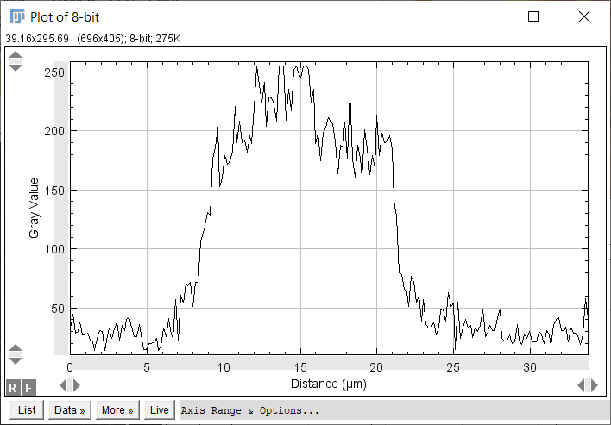
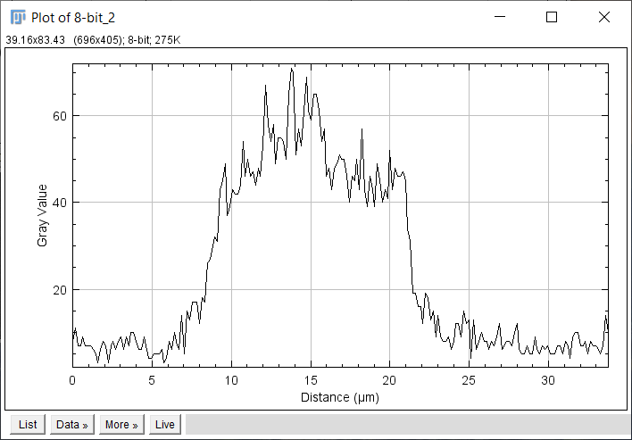
Exercise – plot profile
Solution
Contrast on Auto
Contrast on Reset
Look at the plot profile for the 16-bit images. It stays unchanged. Why’s that?

Slide 8
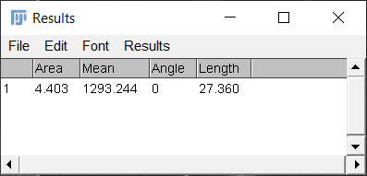
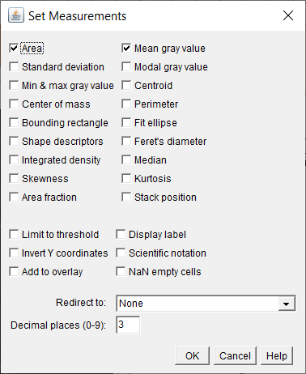
Measure and Set Measurements
With the drawn line, go to Analyze > Measure, or Ctrl + M.
If you deselected it, go to Edit > Selection > Restore Selection (Ctrl + Shift + E) to get the previous selection.
Go to Analyze > Set Measurements to select what is measured on the ROI
It might be different for you.
Notes:
Até aqui é capaz de ser 15-25 minutos. Some of the selections are smart. Try different parameters and see what appears on the results window

Slide 9
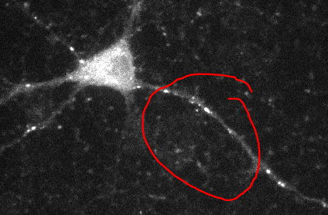
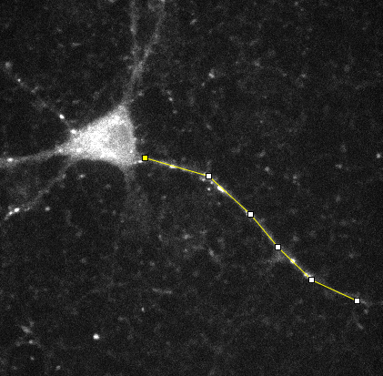
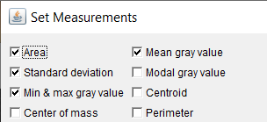
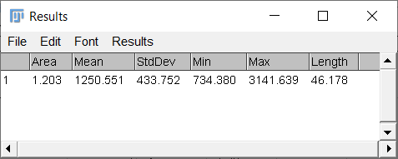
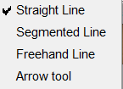
Exercise - Measurements
Your task:
Measure the mean, minimum, maximum, standard deviation and length of this dendrite.
(Hint: Maybe you need to adjust some tool)
Solution
Notes:
Give 5-10 minutes. What happened if you did not close the previous measurement?

Slide 10
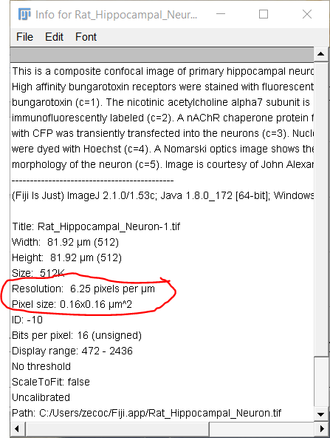
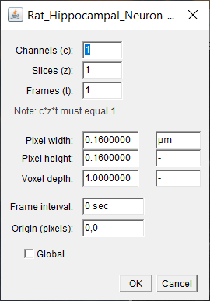
What units were the previous measurements?
Did previous measurements have units? Was it microns, millimeters? How do we know this?
Go to Image > Properties (Ctrl + Shift + P) or Image > Show Info
Notes:
Show info of image

Slide 11
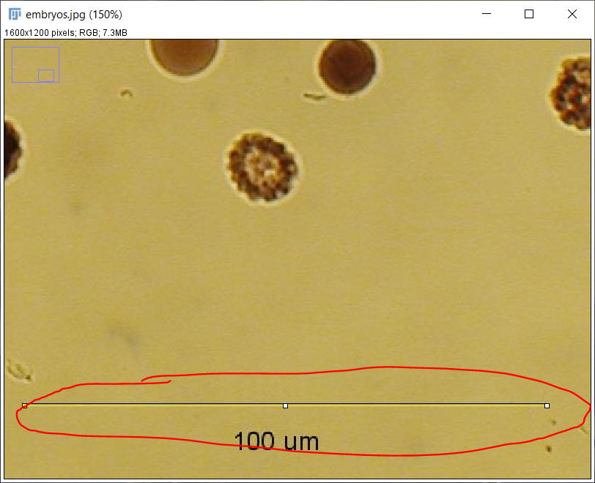
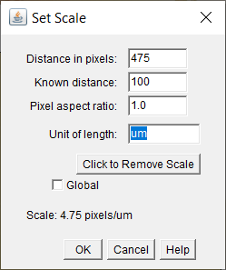
Set scale on uncalibrated images
Open Samples > Embryos.
Analyze > Set Scale
Our known distance was 100 µm.
Fiji considers um == µm
A line is draw over the known length. Zooming in (keyboard shortcut: +) on the image helps.
Notes:
If someone wants to do this, they’re more than welcome. Use the wand tool here.

Slide 12
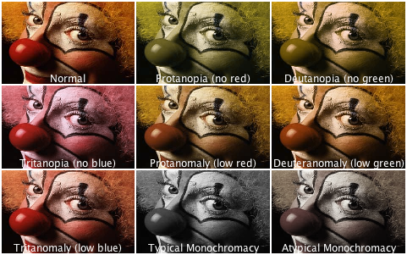
Images in Color and Color images
https://www.osapublishing.org/oe/fulltext.cfm?uri=oe-21-8-9862&id=252779
https://thenode.biologists.com/data-visualization-with-flying-colors/research/
Colorblind friendly 2-color combinations:
Cyan + Magenta
Green + Magenta
Notes:
Linha de cima, composite. Em baixo é tipos de daltonimos

Slide 13
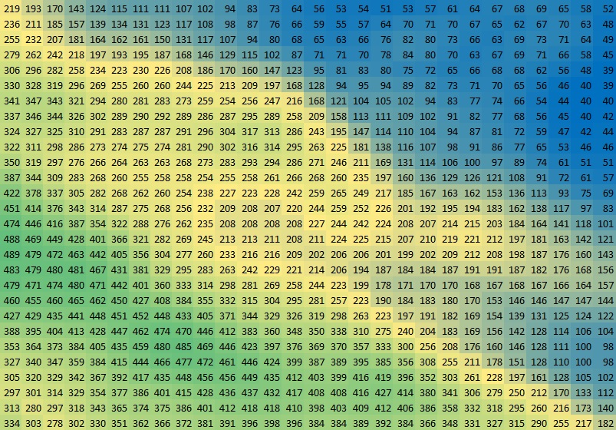
Color in images
Pixel values are the information on the image, not the color.
Color is displayed according to a Lookup Table – LUT, for better visualization.

Slide 14
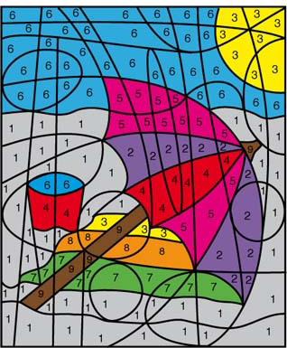
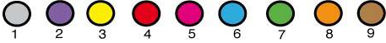
What is a Lookup Table?
A look up table maps the 255 intensity values to 255 arbitrary colors
Screens can only project/make 255 colors per channel (Red, Green, Blue)
A pixel value will correspond to a specific color of the LUT.

Slide 15
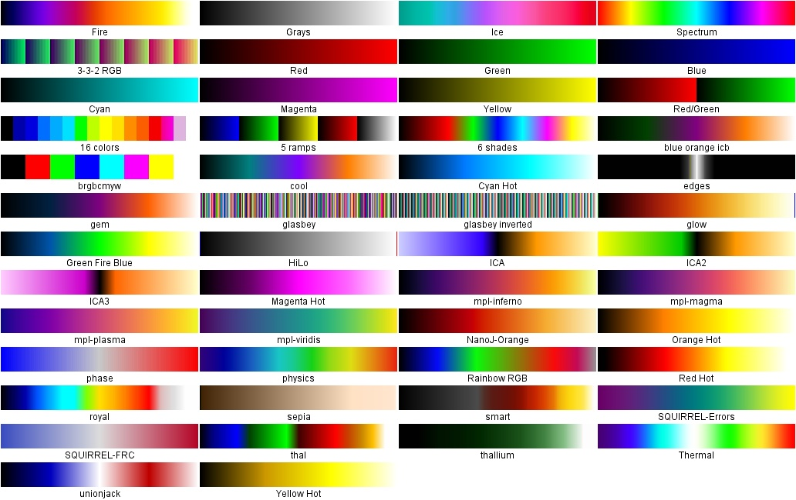
Built-in LUTs
Live Demo:
Let's play with LUTs on the neuron image
Image > Color > Display LUTs

Slide 16
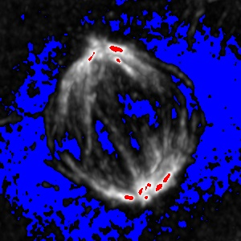
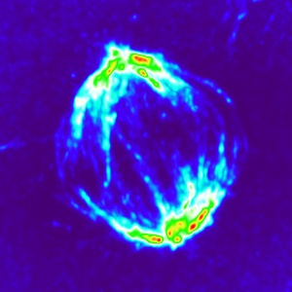
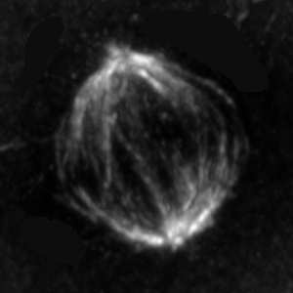
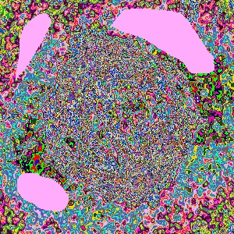
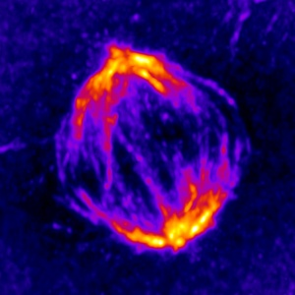
Some useful LUTs
Used for different purposes:
HiLo
Fire
Thermal
Glasbey
HiLo
Thermal
Fire
Glasbey
Notes:
Hilo allows to see saturation
Glasbey lut is good useful to see which areas of the image have the same pixel values. Show a quick demo of glasbey on count masks using blobs

Slide 17
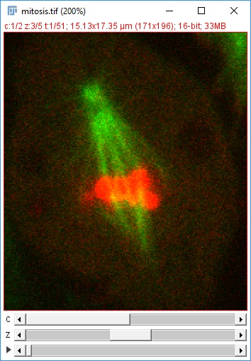
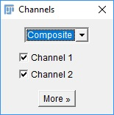
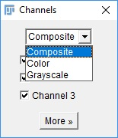
Composite Images vs RGB Images
Multidimensional image in ImageJ is a Composite image (C, Z, T)
Channels can have original pixel values,
Color is false; pseudocolor,
Can work on channels independently,
Open Samples > Mitosis (5D stack)
Channels Tool
Image > Color > Channels Tool (Ctrl + Shift + Z)
More dimensions are just more images in another channel, time or z-plane (normally)
Notes:
Some imageJ functions duplicate images.
Spend time to explain what are the dimensions. Show the composite here.

Slide 18
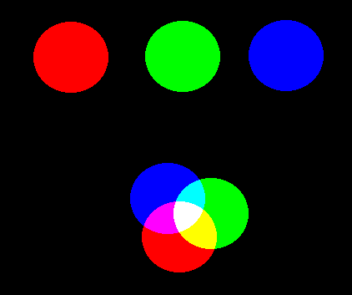
RGB
In RGB (Red, Green, Blue) images, colors are made of components of the 3 basic colors:
Red
Green
Blue
(255, 0, 0)
(0, 255, 0)
(0, 0, 255)
(0, 255, 255)
(255, 0, 255)
(255, 255, 255)
Notes:
Show using pixel inspector

Slide 19
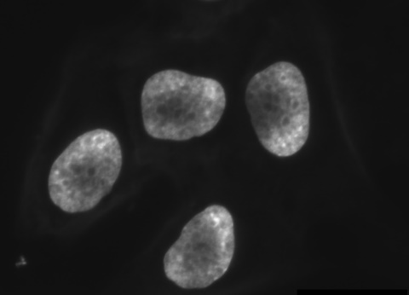
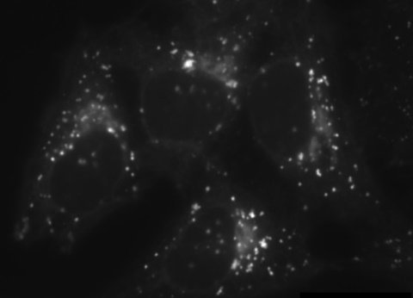
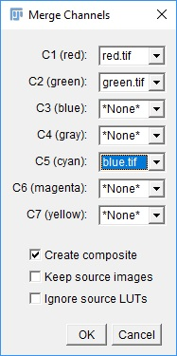
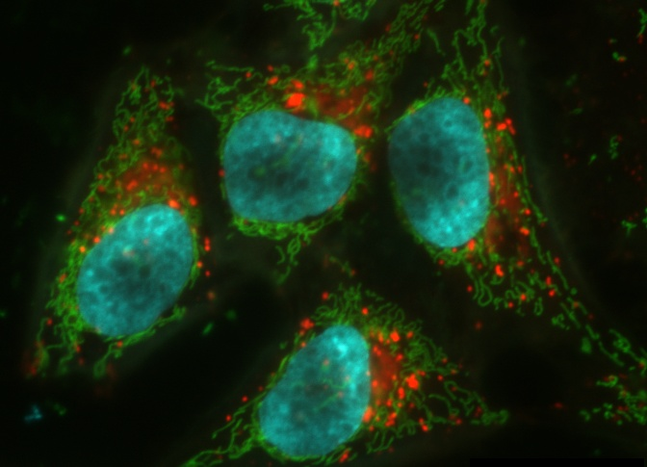
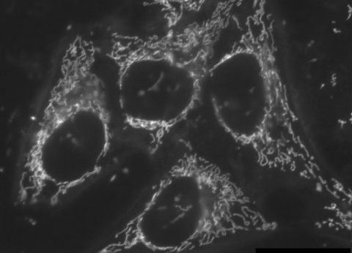
Creating a composite image
Get channel images:
Open samples > Hela Cells
Image > Split Channels
Image > Color > Merge Channels
Select on image per channel/color
Experiment with the bottom options (or whatever options you want)
Notes:
Drive home the fact that you can always change later de color of each channel.

Slide 20
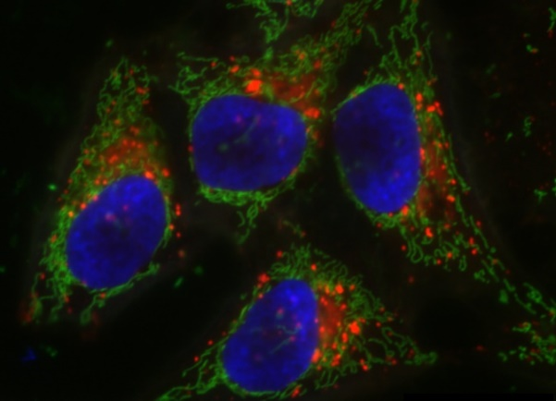

Composite to RGB
Create a composite image by merging previous channels,
As red, green and blue.
Convert to RGB,
Image > Type > RGB color
Or
Channels Tool > More... > Convert to RGB
Split channels of the RGB image
Do the same again but Cyan instead of Blue
Split channels and see what happens to all channels when you split the RGB image.
which channel is different?

Slide 21
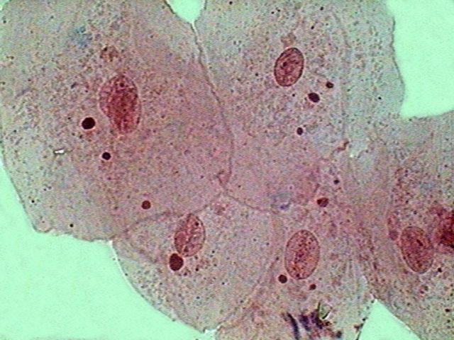
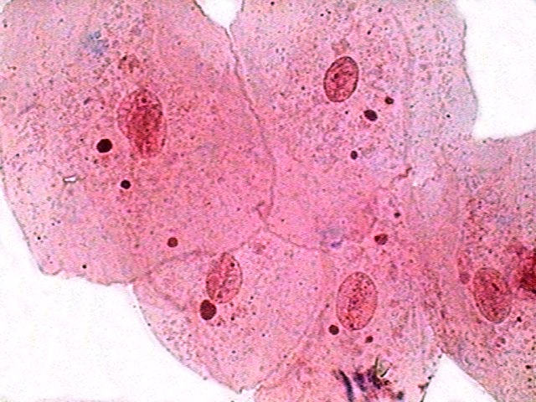
Working with RGB images
When working with color images, these may need to be adjusted.
Colors need to be adjusted manually when acquisition software doesn’t.
ImageJ/Fiji has the tools to do it
Color Histogram
Color Balance

Slide 22
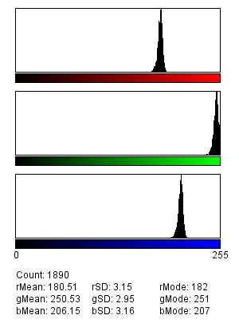
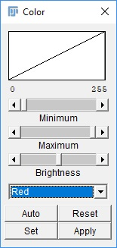
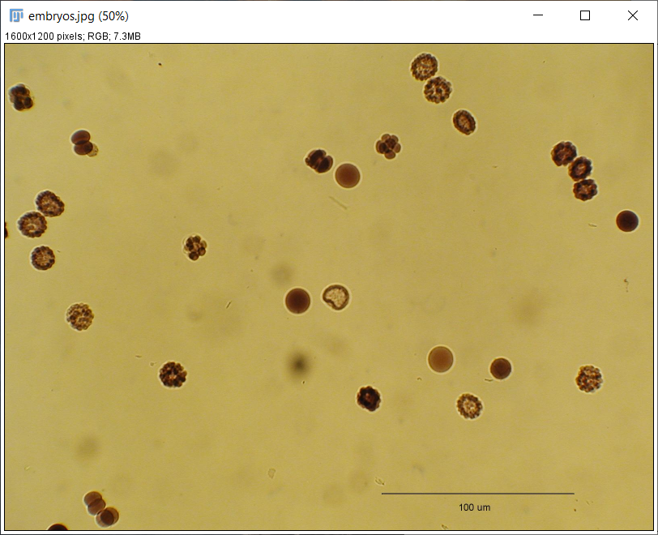
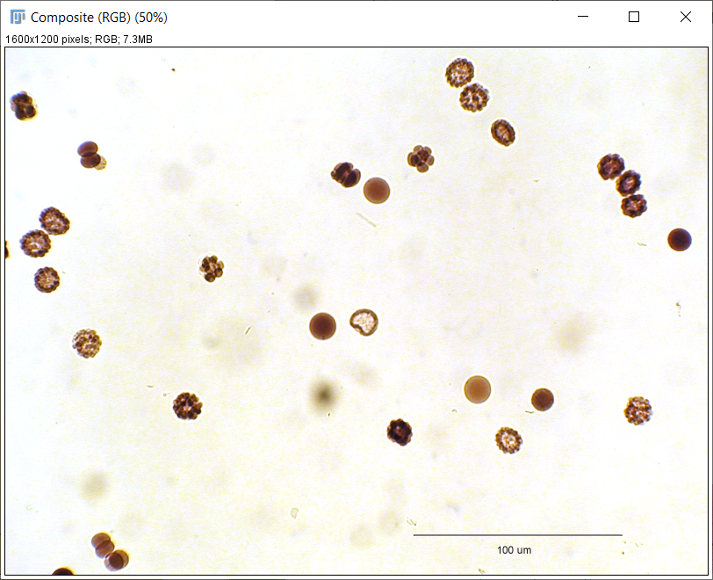
Adjusting RGB images
Open Samples > embryos. Draw a ROI in a white region
Analyze the color histogram
Analyze > Color Histogram
Check the average levels for 3 colors (Red, Green, Blue)
Open the color balance tool
Image > Adjust > Color Balance
Set the Maximum Red value to the rMean.
Repeat for other 2 channels.
Notes:
There’s an alternative way.

Slide 23
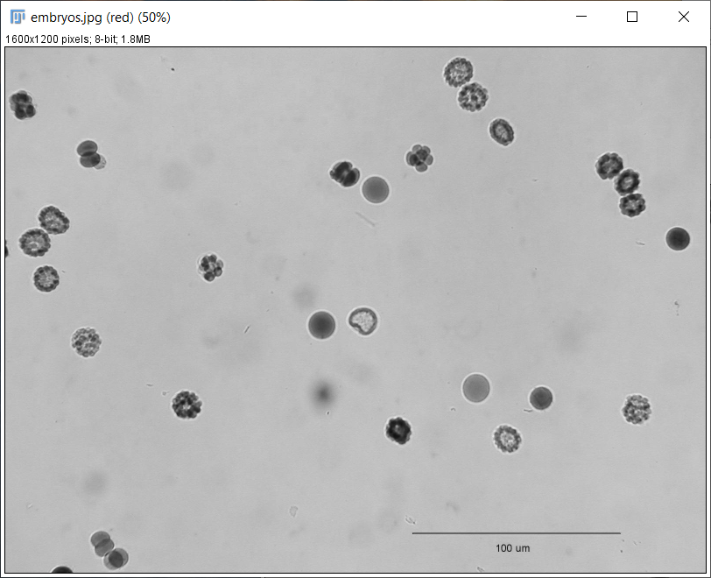
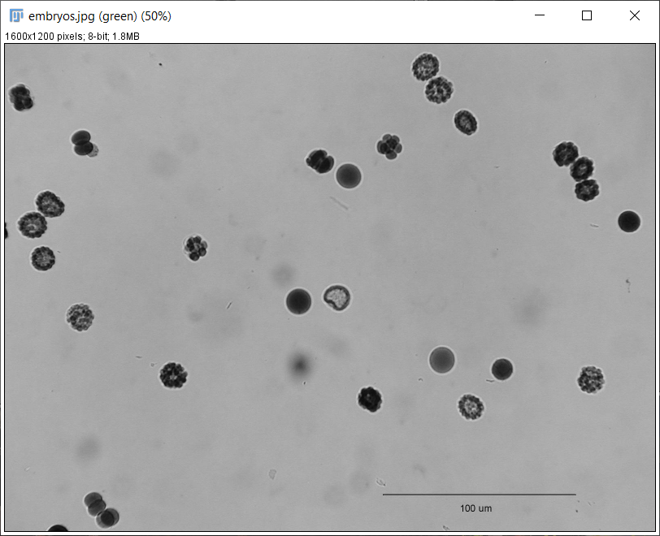
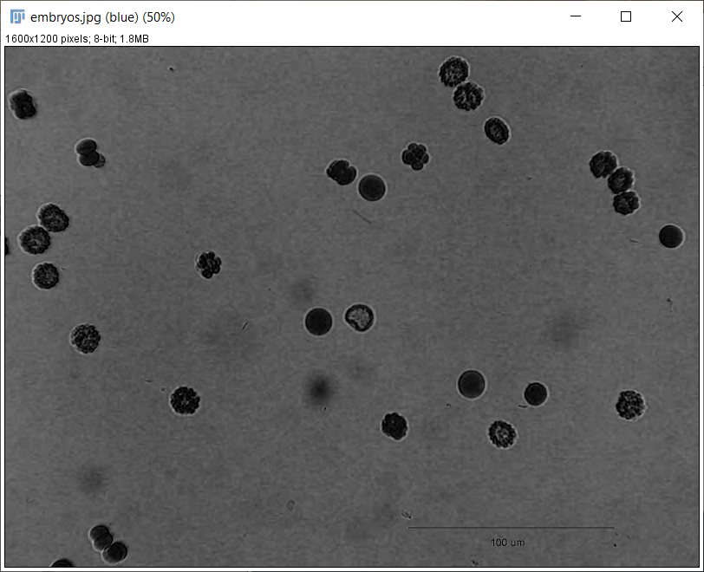



Adjusting RGB images
Another way of doing the same thing - Split channels and adjust each channel individually.
Red
Green
Blue
Adjust histograms
Merge them. Make sure to use the correct colors.

Slide 24

Adjusting RGB images but using a plugin
Cool thing about Fiji – Most likely there’s a plugin that solves your issue.
For color correction, there’s an old plugin called “Colour Correct”. You can find it here - https://blog.bham.ac.uk/intellimic/g-landini-software/
Download the zip file from the github page https://github.com/landinig/IJ-Colour_Correct/blob/main/colour_correct.zip
Unzip inside your Fiji plugins folder.
Restart Fiji.
Follow plugins instructions.

Slide 25

Installing other plugins and Bio-Formats
Open Convallaria_10x.czi
Bio-formats info https://imagej.net/formats/bio-formats

Slide 26

Installing other plugins and Bio-Formats
Fiji update site:
- Help > Update… (the 3 dots are intentional)
Notes:
Needs internet connection. My Fiji was asking for this update.

Slide 27

Installing other plugins and Bio-Formats
Checkmark (✓) the plugins you want to install: - - Install BioVoxxel and IJPB-plugins
- Not all plugins are present in this updater
Click close after you selected all desired plugins.
Then “Apply Changes”
Notes:
Needs internet connection. My Fiji was asking for this update.

Slide 28

Saving images

Slide 29
Lossy vs. Lossless
Format | Name | 8 bit | 16 bit | 32 bit | RGB | stacks | hyper-stacks | Overlays in header | Transpa-rency | Compression
TIFF | Tagged Image File Format | √ | √ | √ | √ | √ | √ | √ | √ | lossless
JPEG | Join Photographic Expert Group File | √ |  |  | √ |  |  |  |  | lossy
GIF | Graphics Interchange Format | √ |  |  | √ | √ |  |  | √ | lossless
PNG | Portable Network Graphics File Format | √ | √ |  |  |  |  |  | √ | lossless
BMP | Bitmap Image Files | √ |  |  | √ |  |  |  | √ | lossless
DICOM | Digital Imaging and Communications in Medicine | √ | √ | √ | √ | √ | √ |  | √ | lossless

Slide 30
Saving images
Good rule of thumb:
TIFF to process and analyze images
PNGs are normally good for publication, but that depends on the journal
JPEG are good to put images in your lab meetings and presentations.
For Big data files (> 500 GB), there are H5, N5 and NGFF image file formats. But that’s for another time.

Slide 31
Take home message.
I don’t know.
Just kidding :P.
Practice, practice and practice. Only by using ImageJ/Fiji often will this things become natural to you too.
There is a lot of information online and a lot of different ways of doing the same thing. Try each one at the time and see what works best for you.
Save always as TIFF.

Slide 32

Homework
Measure Leaf Area and calculate the chlorophyll area percentage.

